Slide 1
LIFE SAVER BLOOD BANK

Slide 2


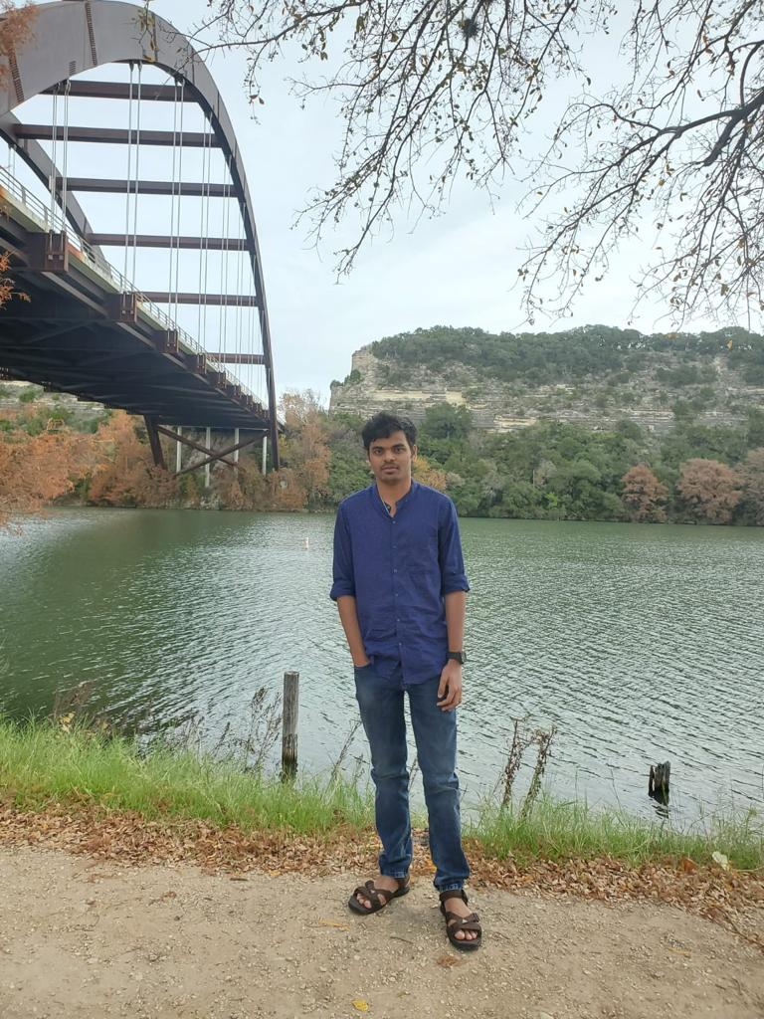
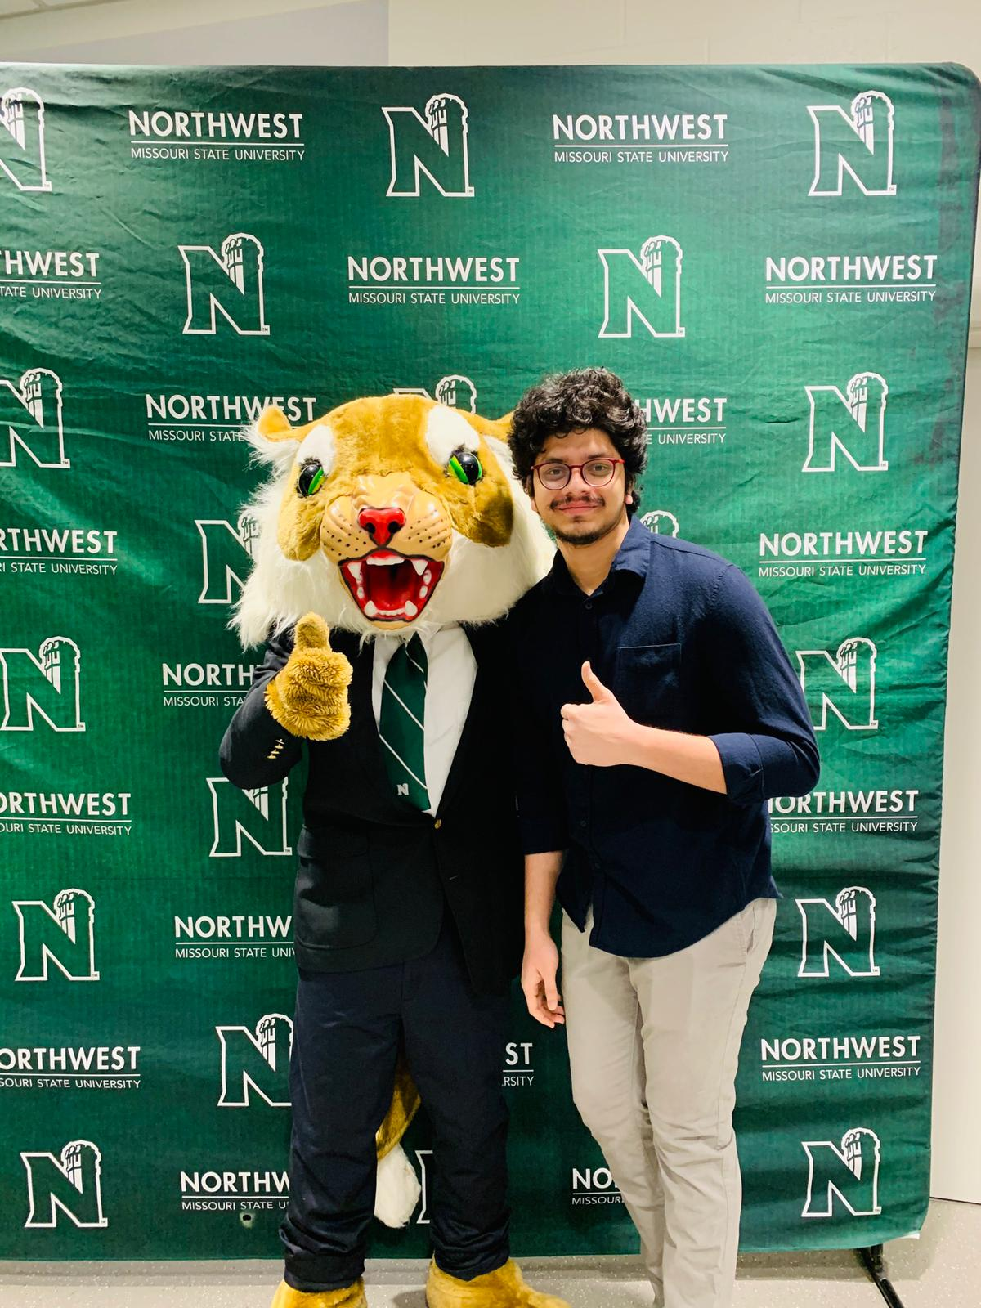

TEAM MEMBERS
Raghunandan Kumar
Mohan Pratapa
Hareesh Bhuma
Venkat Prudhvi
Sumanth Gorantla

Slide 3
Agenda
Introduction
Software and hardware requirements
Entity relation diagram
Firebase configuration
Functionalities

Slide 4
Introduction
Life Saver Blood Bank is an android application which lets the users to request/respond for blood emergency.
Life Saver Blood Bank application provides donors list to the acceptor(s) who are in need of blood.
Life Saver Blood Bank have acceptors who can access the donors list by searching with Blood group.
4

Slide 5
Software and hardware requirements
Required Softwares: Android 5.1
Required Hardware: WIFI services, Call Services, Android Phone with at least 2GB ram.
Raghu

Slide 6
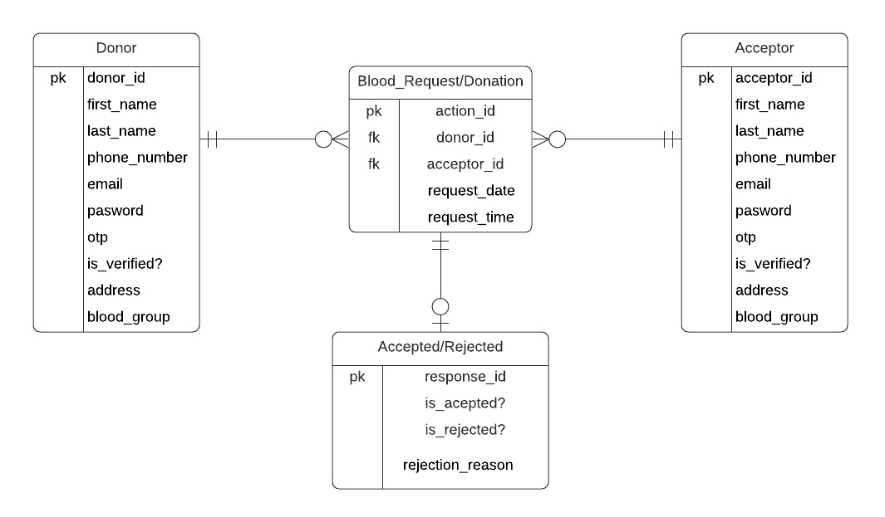
Entity relation Diagram
5

Slide 7
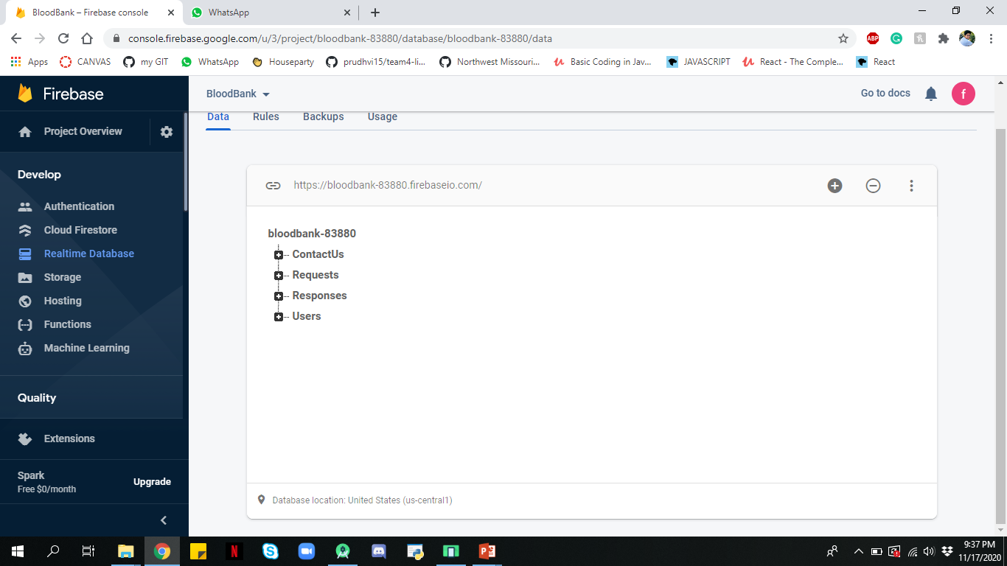
Firebase configuration
Raghu

Slide 8
Functionalities

Slide 9
Raghunandan
Responsibilities:
Home page
Blood request functionality
Profile page UI
Raghu

Slide 10
Raghunandan demo

Slide 11
Mohan
Responsibilities:
Donors functionality
FAQs(UI & Functionality)
Notification UI
Chat Functionality
Mohan

Slide 12
Mohan demo

Slide 13
Sumanth
Responsibilities:
Blood Request UI
Notification Functionality
About us
Sumanth

Slide 14
Sumanth demo

Slide 15
Hareesh
Responsibilities:
Donor search functionality
Response UI
Logout functionality
Contact US
Hareesh

Slide 16
Hareesh demo

Slide 17
Prudhvi
Responsibilities:
Blood Donor UI
Response functionality
Profile page functionality
Prudhvi

Slide 18
Prudhvi demo

Slide 19
Any queries?
Raghunandan Kumar
Mohan Pratapa
Hareesh Bhuma
Venkat Prudhvi
Sumanth Gorantla

Slide 20
Thank You
20

